Slide 1
5/14 Presentation

Slide 2
Adaptive Pooling
What is it? (ChatGPT)
Pooling (non-trainable) layer that goes after convolutional layers but before dense layers
How does it work?
Adaptive pooling layer picks stride and kernel values for each new image such that output layer is uniform size
All values within the kernel are averaged (pooled together) -> Spacial reduction
Then why do we need to pad?
Convolutional layers can take any input size ✅
Dense layers need a fixed size, but we add Adaptive pool layer right before to create a fixed size ✅
BUT data loaders need a fixed input dimension within batches!
Approach #1: Just pad up to largest image size in that batch
Approach #2: Batch images by similar size -> Less padding

Slide 3
Approach #1: Padding to a consistent size within-batch
1) Resize only images > 400 pixels (small % of all images) for compute efficiency (less padding)
2) We pad all images to the size of the largest image in that batch -> Uniform dimensions within batch
Padding doesn’t hurt performance bc CNNs can learn that padding doesn’t influence the class value (ChatGPT)
We need to pad bc data loader needs consistent image size
3) All images pass through the CNN with adaptive pooling

Slide 4
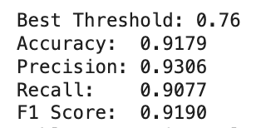
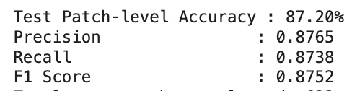
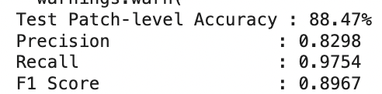
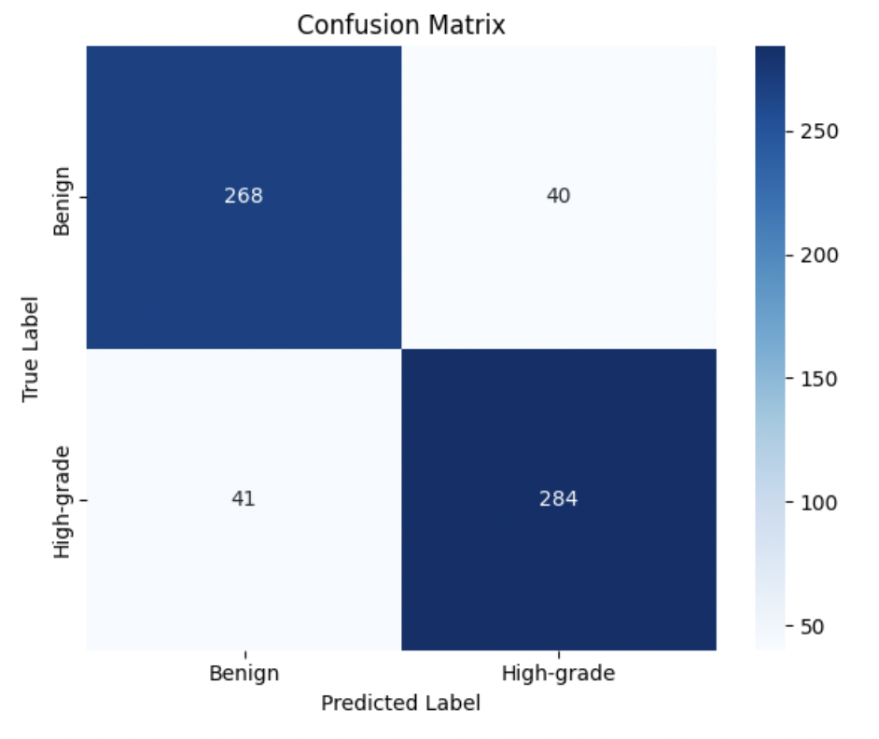
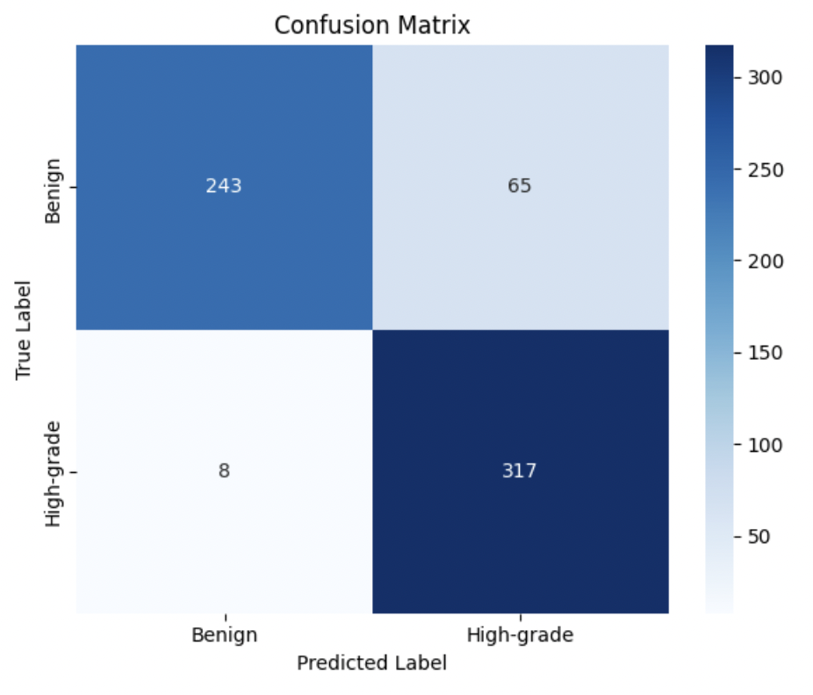
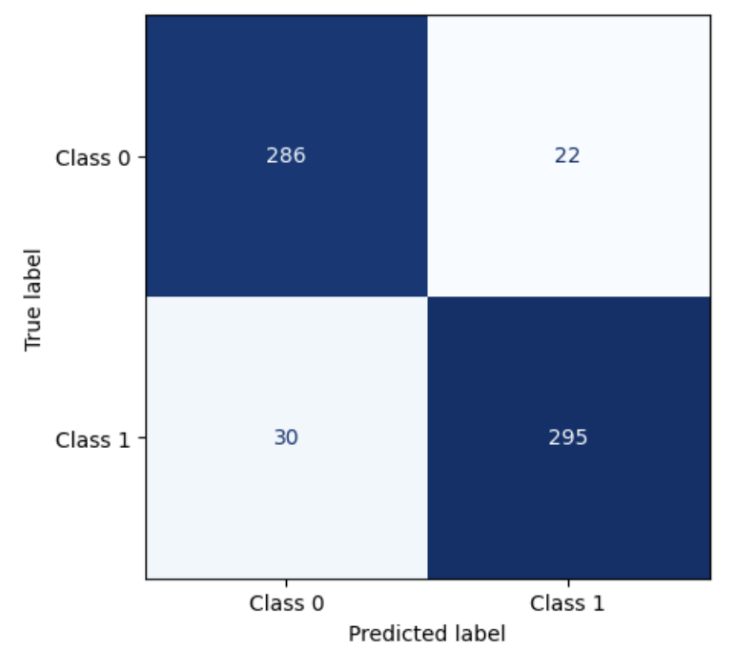
Approach #1 Performance (adapool colab) (normal cnn colab)
Approach #1 (No Threshold Tuning)
Approach #1 (w/ Threshold Tuning)
Normal CNN
Notes:
This is with a 6x6 output size outperformed an 8x8 output size
This w/ n = 400 outperformed n = 200

Slide 5
Approach #2: Bucketing
1) Resize only images > 512 pixels (small % of all images) for compute efficiency (less padding)
2) We group images into 10 different sizes, and pass only images in the same “size bucket” into data loader at once -> Less padding
Padding doesn’t hurt performance bc CNNs can learn that padding doesn’t influence the class value (ChatGPT)
We need to pad bc data loader needs consistent image size
3) All images pass through the CNN with adaptive pooling

Slide 6
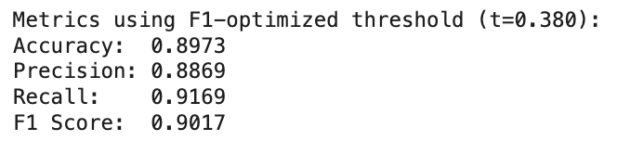
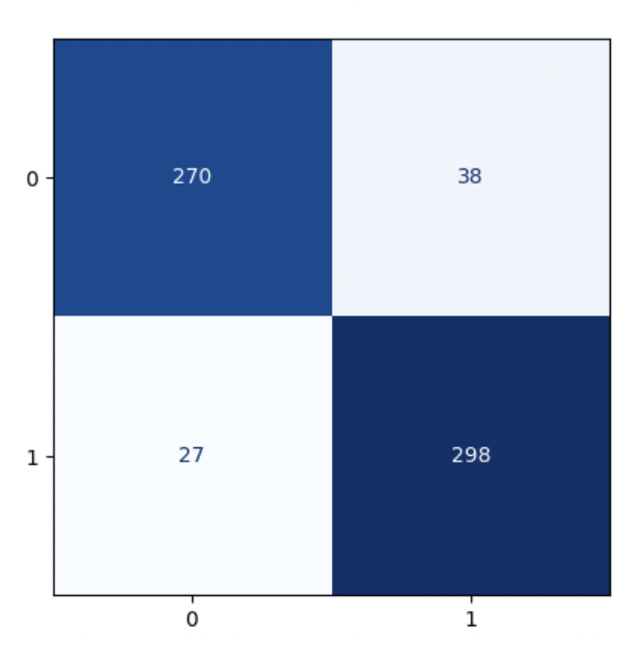
Approach #2 (Bucketing) Performance (approach #2 (bucketing) colab) (approach #1 colab)
Approach #2 (10 Buckets)
Approach #1

Slide 7
If one unfrozen layer works, why not unfreeze two layers?
How do we calculate # trainable params? (source)
# trainable params = (# input nodes + 1)*(# output nodes)
# trainable params w/ 1 unfrozen layer
Final Dense Layer
(4096+1)*2 = 8194
Total = 8194
# trainable params w/
2 unfrozen layers
2nd to Last Dense Layer
(4096+1)*4096 = 16781312
Final Dense Layer
(4096+1)*2 = 8194
Total = 16789506

Slide 8
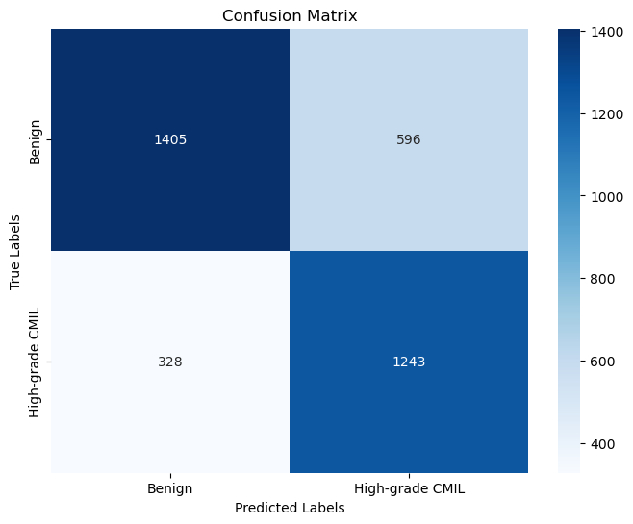
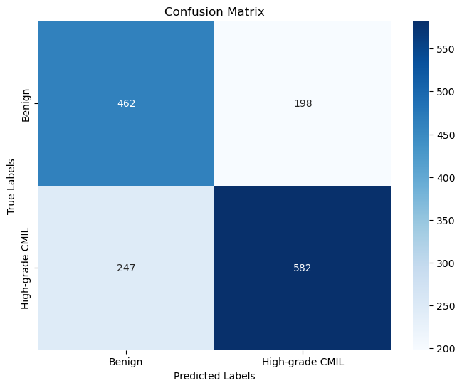
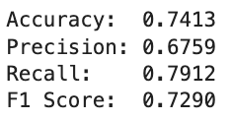
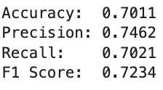
ResNet with CBAM on new patches
New
Old

Slide 9
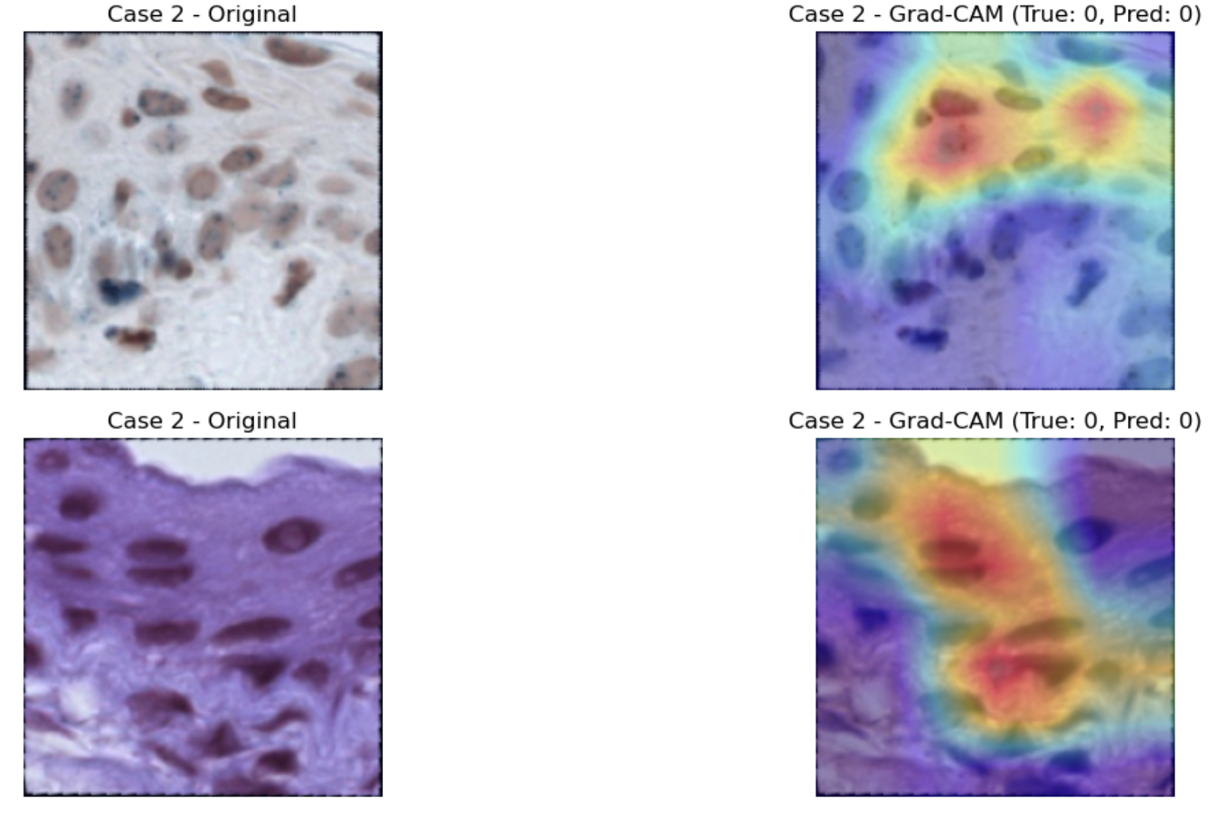
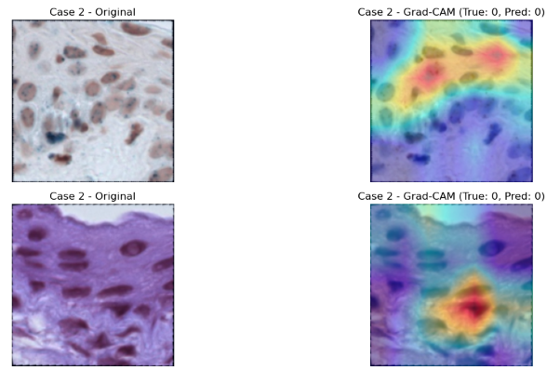
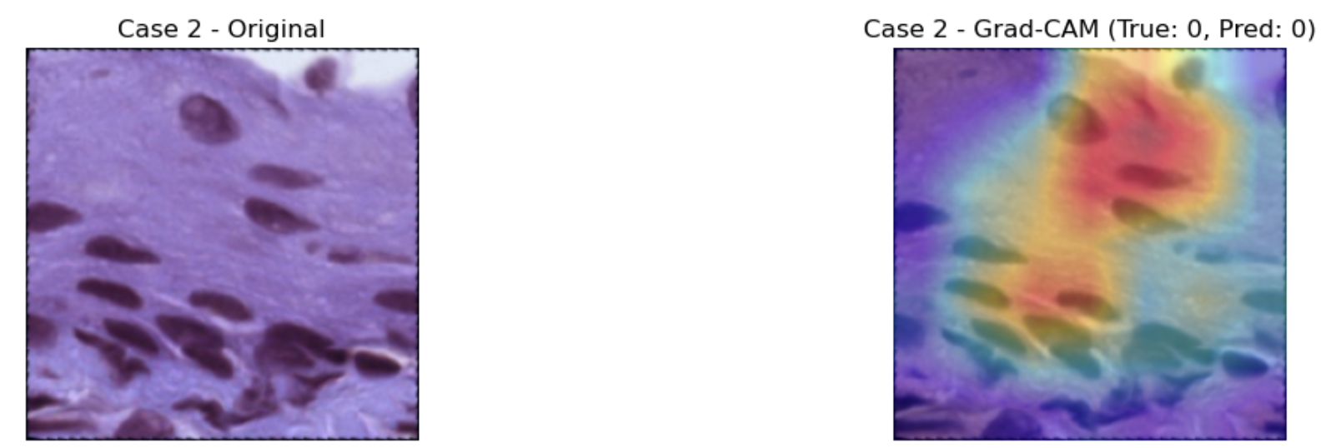
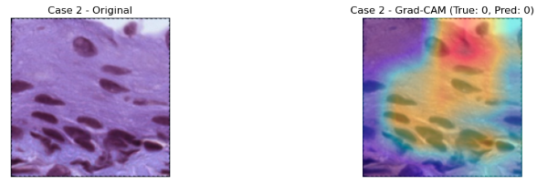
Model focus with CBAM
Model focus without CBAM

Slide 10
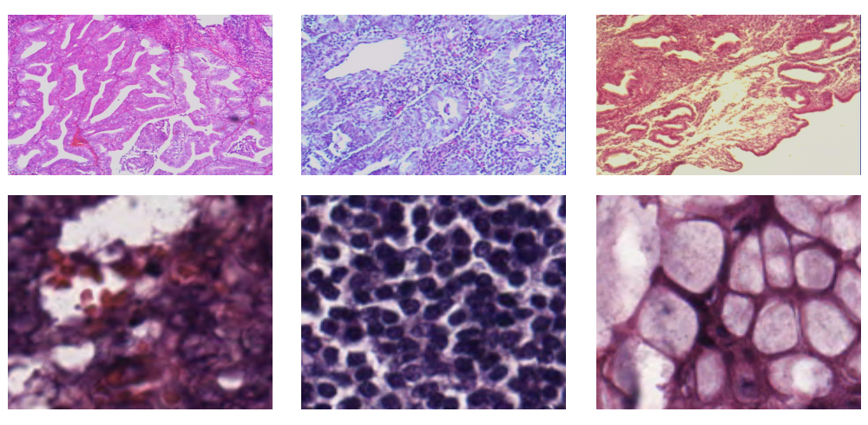
New Model: KimiaNet (fine-tuned on histopathology images)
Employs the topology of the DenseNet with four dense blocks, fine-tuned and trained with histopathology images in different configurations
Trained on more than 240,000 image patches publicly available through The Cancer Genome Atlas (TCGA) repository
Fewer parameters than deeper ResNets; more efficient to train
No built-in attention mechanisms
Source: Riasatian et al, Fine-Tuning and Training of DenseNet for Histopathology Image Representation Using TCGA Diagnostic Slides
https://arxiv.org/pdf/2101.07903

Slide 11
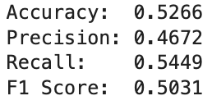
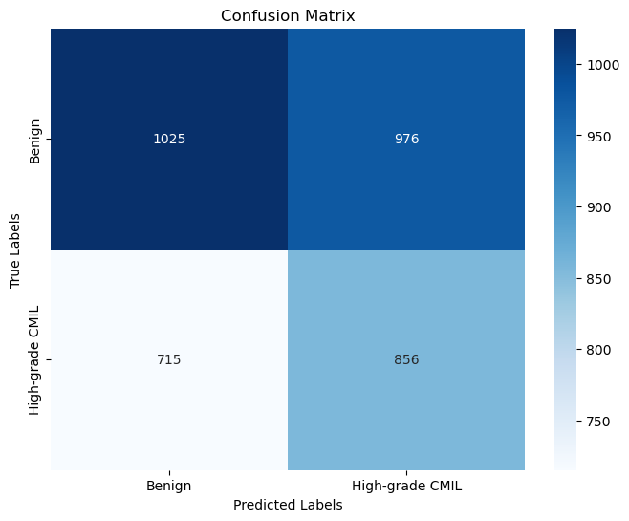
Possible Issues:
Lack of fine-tuning
Learning rate, decision threshold
Unfreeze additional layers
Overfitting on small dataset
Use more pases and patches to train

Slide 12
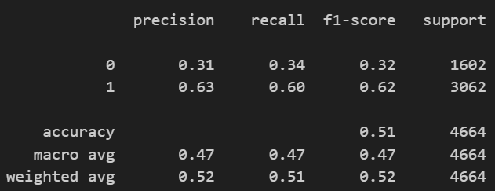
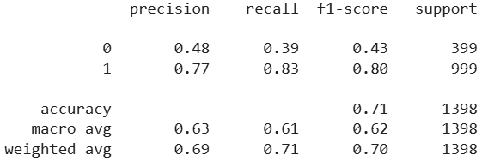
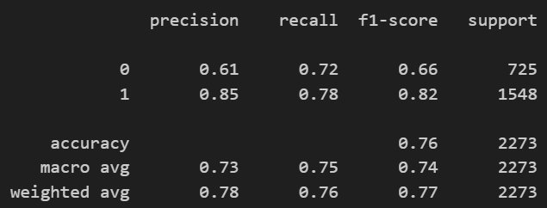
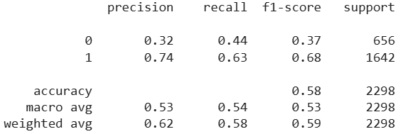
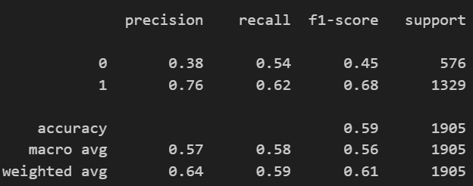
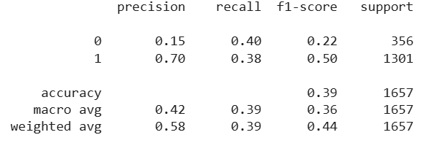
ResNet Comparisons New VS Old Patches
H&E
Melan-A
SOX10

Slide 13
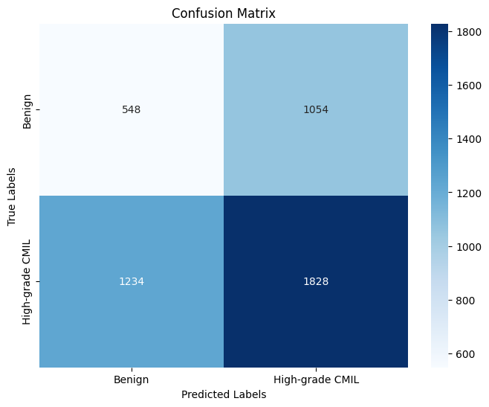
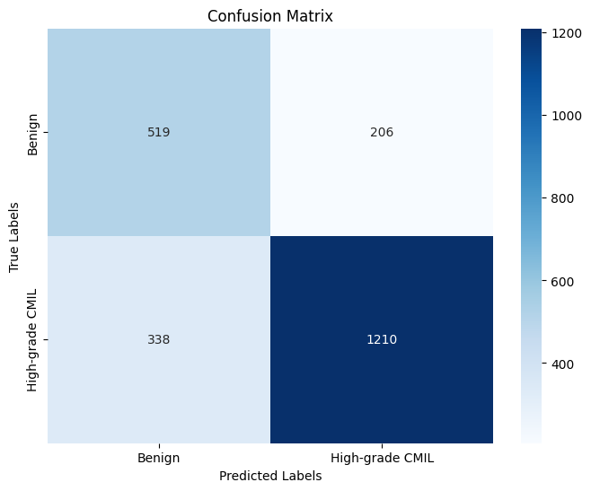
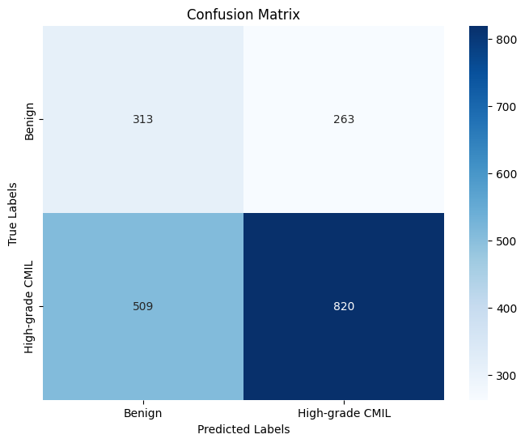
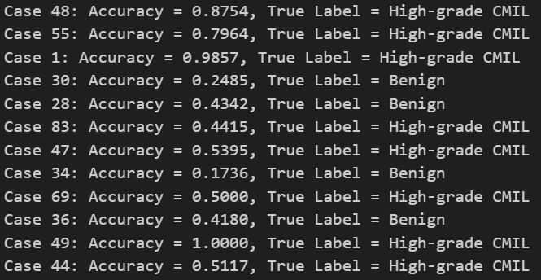
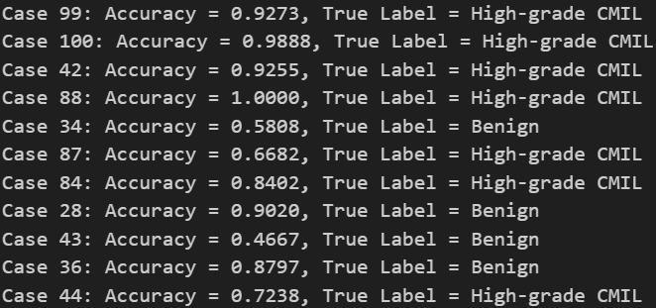
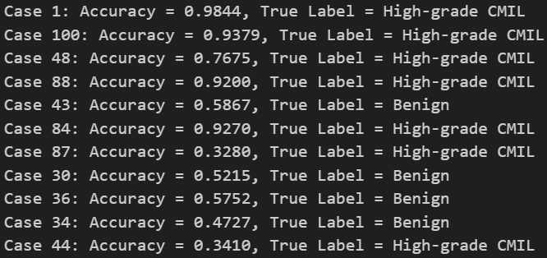
ResNet New Patches Performance
H&E
Melan
SOX

Slide 14
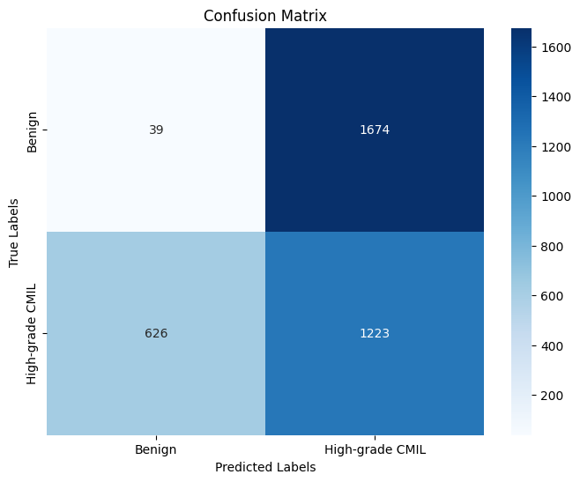
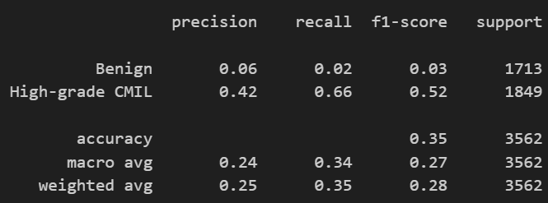
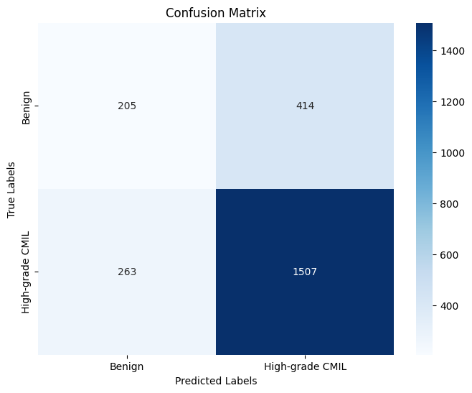

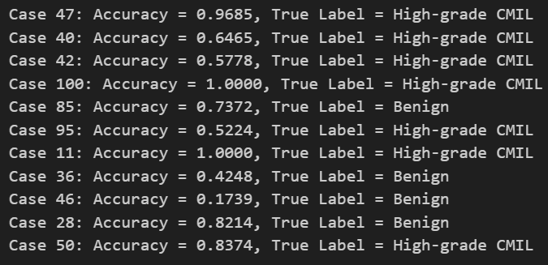
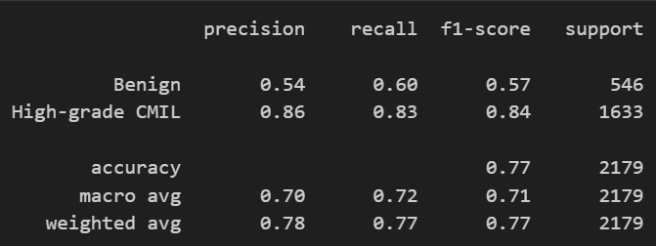
Simple CNN Performance
H&E
Melan-A
SOX10

Slide 15
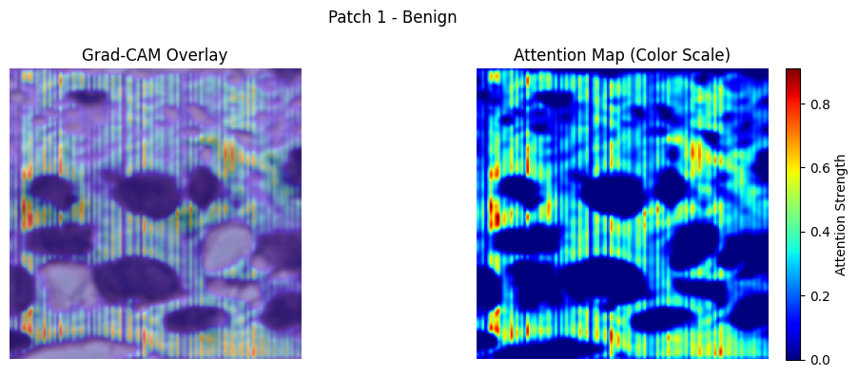
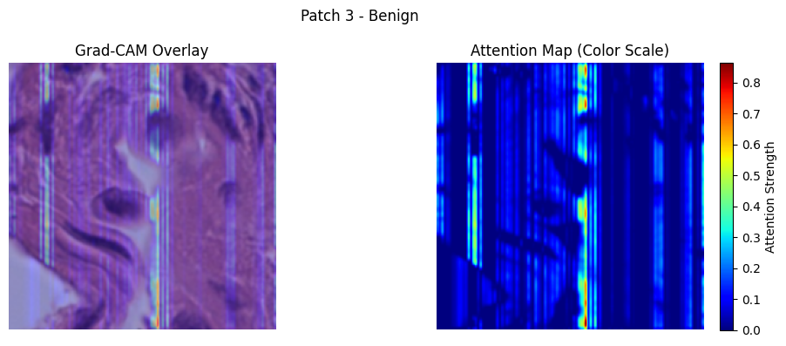
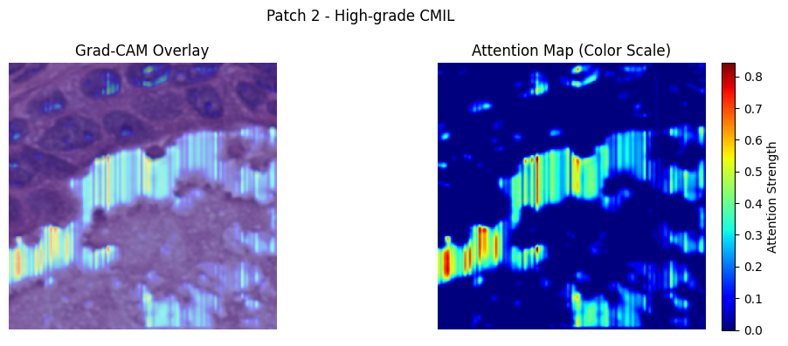
Simple CNN Inference H&E

Slide 16
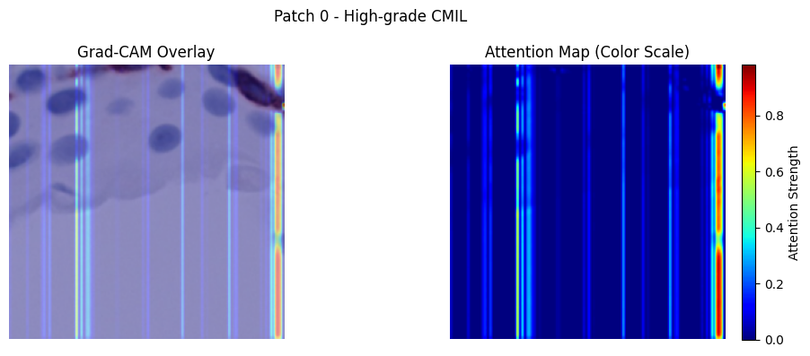
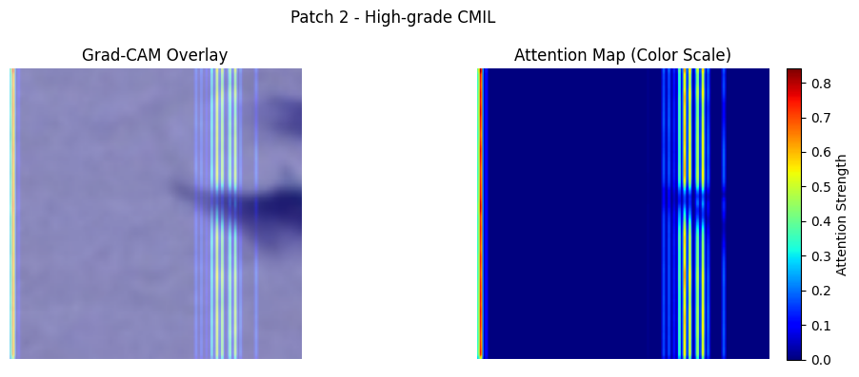
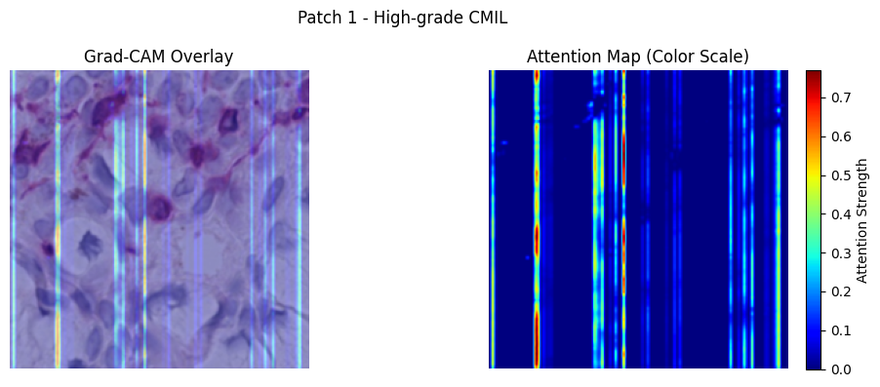
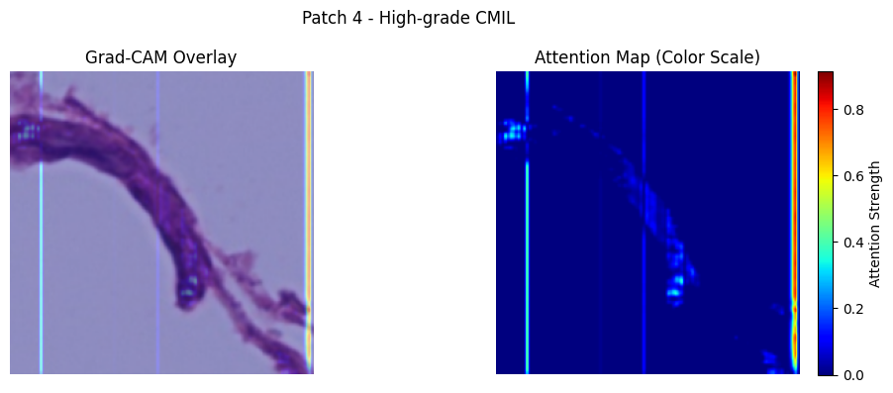
Simple CNN Inference Melan

Slide 17
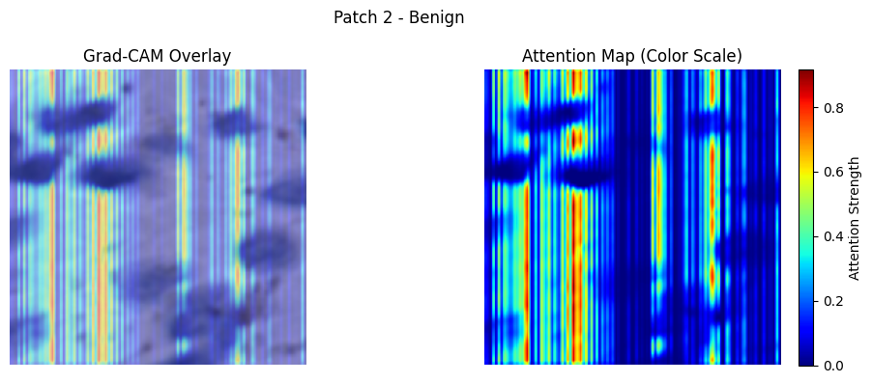
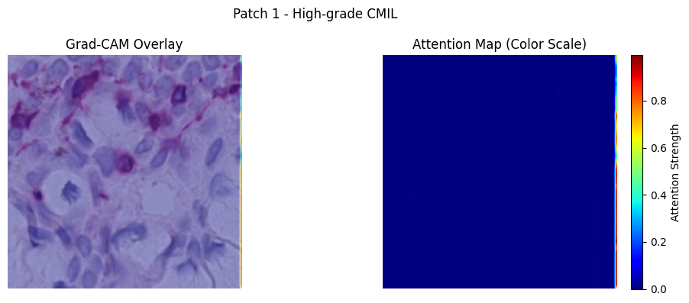
Simple CNN Inference SOX

Slide 18
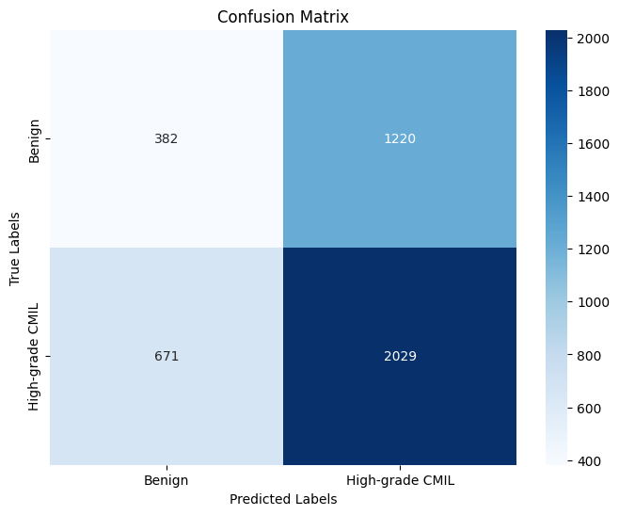
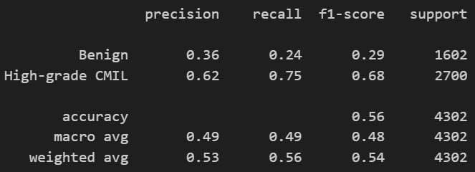
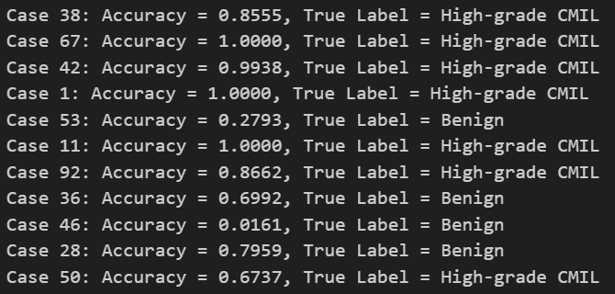
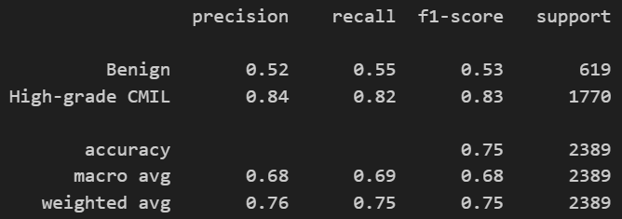
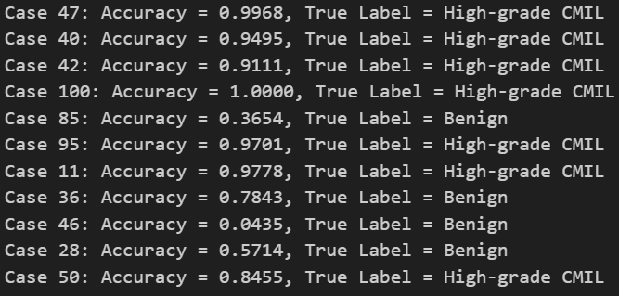

CoAtNet Performance
H&E
Melan-A
SOX10

Slide 19


Densenet Patch Classifier on New Patches (h&e)
New
Old
Notes:
The Densenet patch classifier trained and tested on the new H&E patches did not perform better, it’s having a harder time identifying benign patches.
So the old densenet classifier was trained on a curated list of cases that Krish gave us, and the new model is trained on just the CMIL patches April 27th folder. I haven’t filtered the folder by patch images or size beforehand, and that’s something I plan to do next.

Slide 20


MIL Model w Densenet (h&e)
New
Old
Notes:
Here, I’m comparing the MIL model trained on the new patches. So the results show that the model reaches 56% case level accuracy which is lower than the old patch set case level accuracy of 67%.
To better understand why, I visualized the attention weights the model assigns to individual patches within each case.
(- how densenet is injected into MIL, each patch is first passed through the DenseNet feature extractor to generate a feature map. This map is then reduced using adaptive pooling to create a single feature vector per patch. I freeze the convolutional layers of DenseNet during MIL training — meaning I don’t update the weights — so the model simply processes the input and returns learned patch features. By doing this, I could make sure that the features are being learned during patch-level training, and that MIL can focus on learning how to weigh and combine these features.)

Slide 21

Visualizing MIL Attention
Notes:
This is a test case that was correctly predicted. The top row shows the top 5 most weighted patches, while the bottom row shows the least weighted.
What’s immediately obvious is that the model is placing high attention on much lower-quality patches while ignoring well-structured, high-cell-density patches that show more details.
In this case, the prediction was correct, but it’s clear that the reasoning is wrong.

Slide 22

Visualizing MIL Attention
Notes:
And in this slide, it’s even more clear that the patches that MIL is assigning more weight to are not informational. I think the issue was that I’m feeding the MIL model all patches from each case without any filtering in the new patches folder.
So moving forward, I’m going to go back and filter the patches from the raw patches folder based on David’s size analysis, and also I plan to branch out from the densenet classifier for my patch level training, and use faster, more high accuracy ones like resnet or even just David’s CNN, just because densenet is slow at running and it isn’t giving a very significant boost in accuracy.
How attention works:
(Once each patch is represented as a feature vector through the convolutional layers, the attention mechanism learns to assign a weight to each patch within the bag. It does this by passing each patch embedding through a small neural network with an activation function (This function helps the network capture both positive and negative importance and introduces non-linearity so the model isn’t just doing a simple average), producing an attention score. Then, these scores are normalized using a softmax function, so they sum to 1 across the bag. Then with the weighted average of all the patches, it’s then classified into benign or high grade.)
The attention mechanism in my MIL model is a soft, post-hoc attention mechanism that operates at the instance (patch) level. It assigns a scalar weight to each patch's feature vector, to be aggregated into a case-level classification.
Why is it focusing on the noisy labels: Since attention Weights Are Learned via Gradient Descent, it starts with assigning a random set of weights or attention scores to each of the patches and then
the small neural network inside the attention module starts learning the weights. During training, the model makes predictions (e.g., benign or high-grade), compares them to the ground truth labels, and computes a loss (like cross-entropy). Then, using backpropagation, the model calculates how much each weight in the network contributed to the error. So the gradient descent is used to adjust those weights. This means, that if there are lots of noisy labels, the model can incorrectly start focusing more on those patches. the model may incorrectly learn to assign high attention to misleading patches, simply because those happened to help minimize the loss early on.

Slide 23



Case 53
h&e
melan
sox10

Slide 24






Cross-stain Patch Testing on Nice Matches - case 53

Slide 25



Case 68
h&e
melan
sox10

Slide 26






Cross-stain Patch Testing on Nice Matches - case 68

